Slide 1
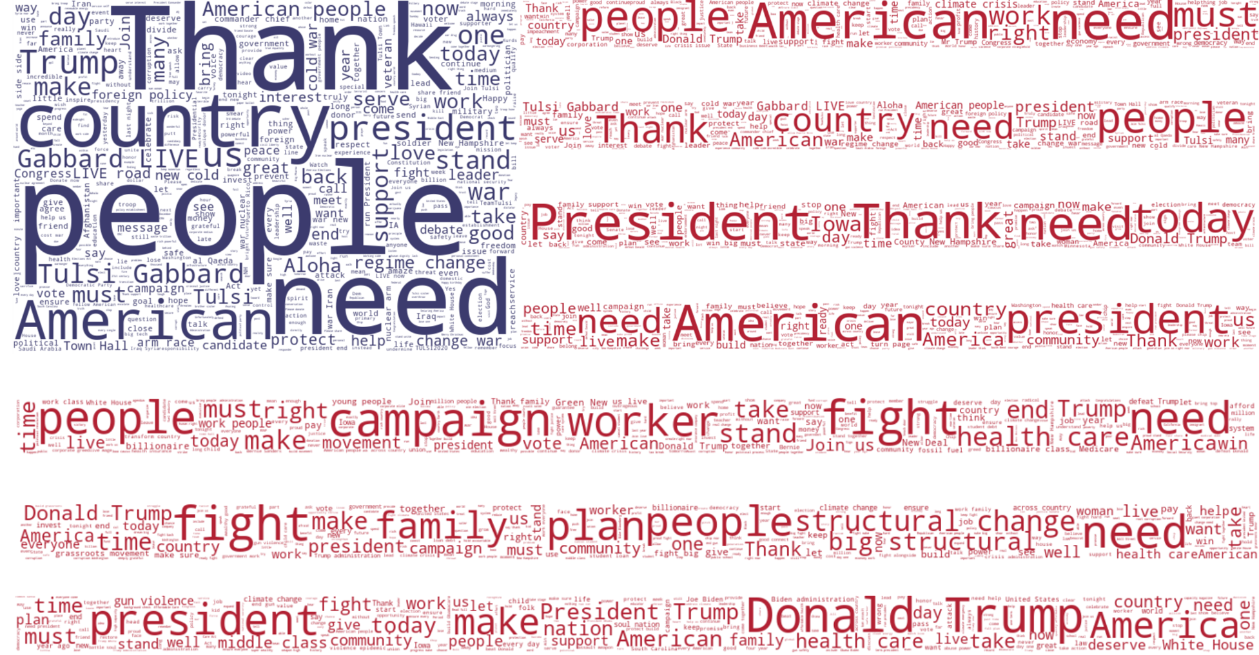
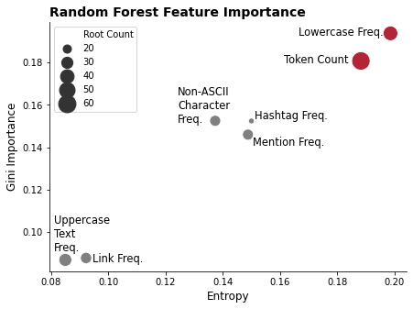
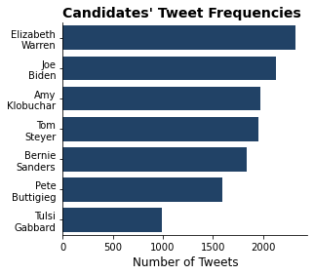
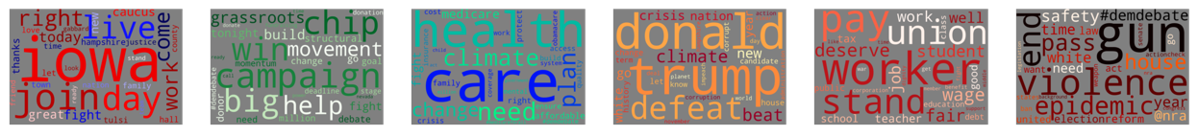
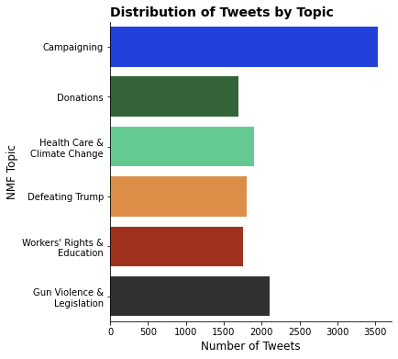
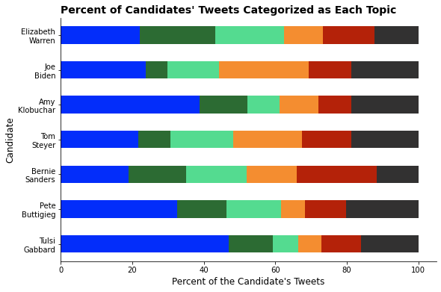
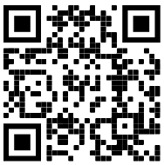
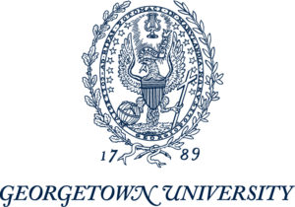
Tweeting Democracy! A look at the tweets of the 2020 Democratic Presidential Nominee Hopefuls
INTRO:
Twitter has evolved into a key platform for modern politics – offering politicians a fast and efficient way to communicate their message to the general public. By looking at the tweets made by seven major Democratic Party Presidential Nominee hopefuls, we sought to better understand how the candidates used this evolving platform to engage Americans.
THE DATA:
The data was collected from Twitter’s API and contains 13,814 tweets from the seven most prominent nominee hopefuls from the start of campaign season (August 2019) through Super Tuesday (March 2, 2020).
METHODS:
Data Collection (API Interfacing)
Data Cleaning & Wrangling
Exploratory Data Analysis
Authorship Detection
Traditional Stylistics—Mendenhall & Kilgariff Methods
Supervised Machine Learning
Topic Modeling
Latent Dirichlet allocation
Non-negative matrix factorization
Each ‘stripe’ corresponds to a candidate… can you guess who?
RESULTS:
Stylistically, tweets originating from Mayor Buttigieg and Mr. Steyer’s campaigns were the most similar to the collective field, whereas tweets from Senators Sanders and Warren were most different.
With a corpus of 75 tweets from a single unlabeled account (about one week of activity), the correct author was correctly identified with >98.6% accuracy using Kilgariff’s Chi-Squared Method.
The use of all lowercase words and the token count per tweet were the two most important features for correctly identifying a tweet’s author.
About 41% of the candidates’ tweets were focused on general campaigning and/or raising money.
Proportionally, President-Elect Biden tweeted the most about defeating President Trump.
The proper author was correctly identified for 35% of tweets using a Random Forest model– the correct author appeared as a ‘Top 3’ prediction 69% of the time.
Authorship
Detection
Topic Modeling
Take a picture or use the link to go to our GitHub repo with the full report and code.
https://bit.ly/TweetingDemocracy
Hanna Born,
Tom Malejko,
Nicole Yoder

